Slide 1
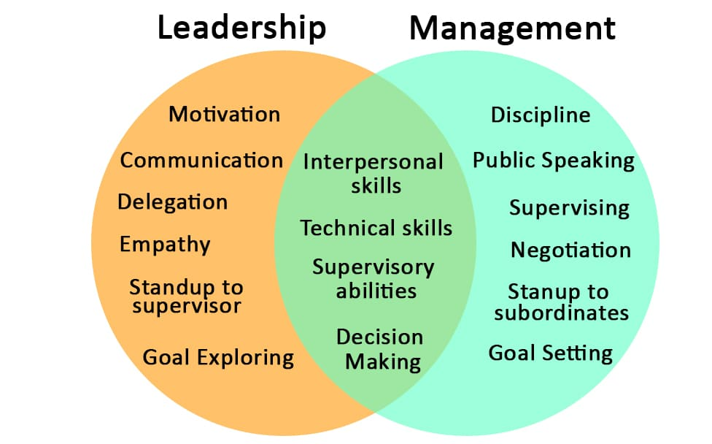
Leadership & Management
Leadership:
  Combination of varies leadership styles to attain a goal.
  Caring, communicative and open for others well being.
  A style that employees can follow.
P-O-L-C Framework:
  Planning - Creates goals and or outlines.
  Organizing – Develops strategies to ensure the success of the companies' objections.
  Leading – Lead by examples to motivate them (team)
  Controlling – Ensuring the success of each employee with performance checks and frequent discussions.
Democratic Leadership:
  Collaboration with teams to encourage ideas and share ideas.
  Encourage Creativity.
  Groups are encouraged to share their ideas and leads to better ideas.
  Increases high productivity.

Slide 2
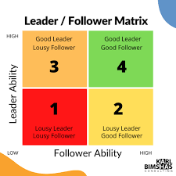
Followership
Agreeableness:
  Tolerant
  Sensitive
  Trusting
  Kind
  Avoids conflict
Openness:
  Curious
  Original
  Intellectual
  Creative
  Abstract and realistic thoughts
Conscientiousness:
  Achievement-Oriented
  Organized
  Dependable
  Prone to perfectionism

Slide 3
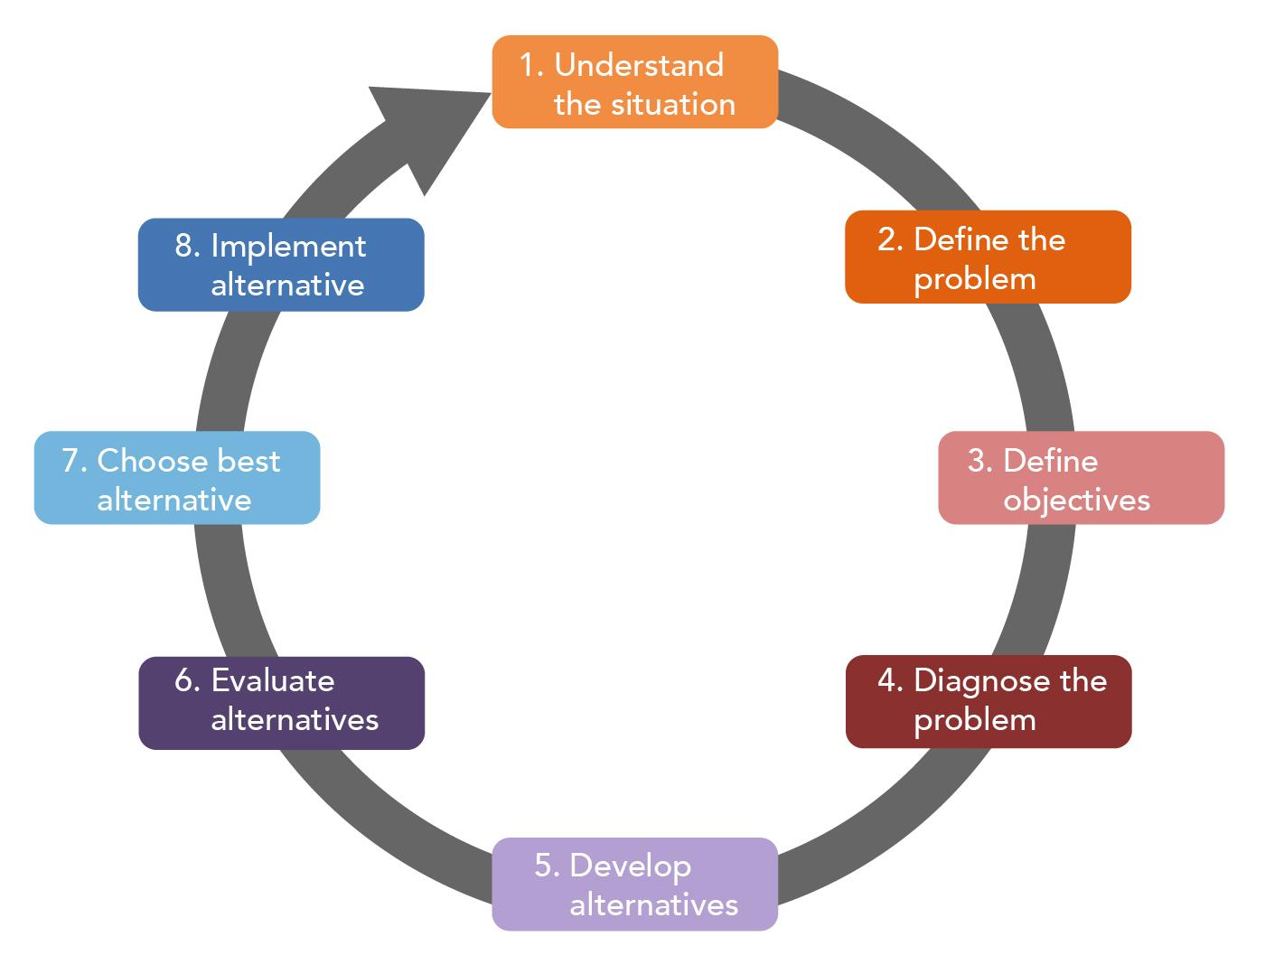
Decision-Making Model
Rational Decision Model
  Most basic model used by hiring managers and or leaders.
  Consist of steps in total of 8.
  Ability to analyze best options seemed best fit.
Intuitive Decision Model
  Used when a limited time or resources are an option.
  Ability to make decisions with experience on certain topics.
  Best suited for knowledgeable professionals.

Slide 4
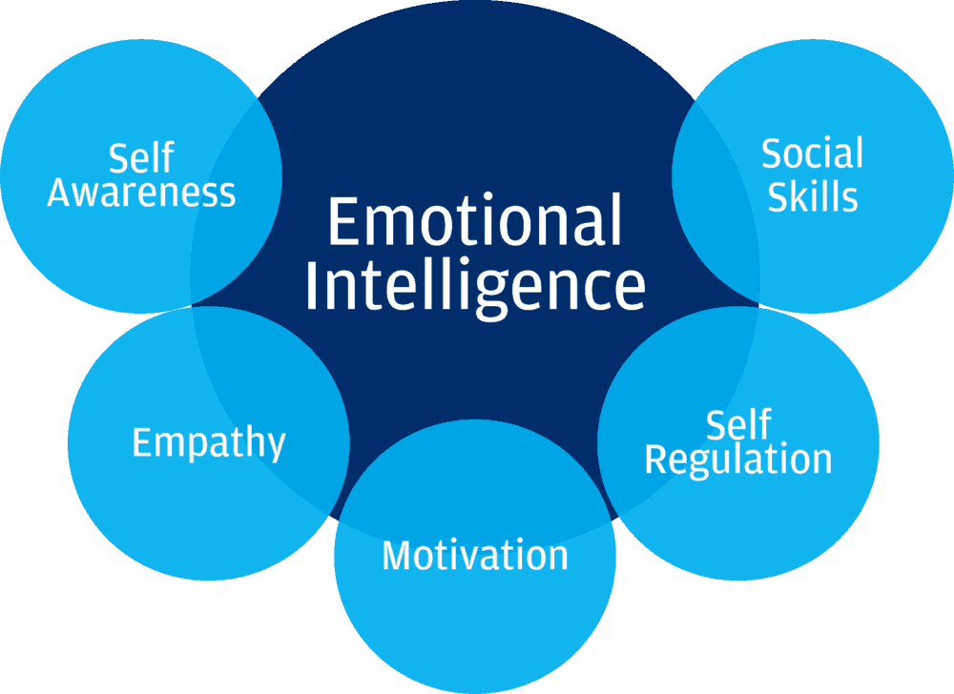
Emotional Intelligence
Its an ability that individuals have access to that can control their emotions as well as measuring others' emotions as well.
With emotional intelligence. There are building blocks that are structured:
  Self-Awareness: Measures emotions or accurately perceive emotions.
  Self-Regulation: Ability to control emotions.
  Social Awareness: Being able to relate to correlate to other feelings and emotions.
  Relationship Management: Being supportive by listening to other feelings.

Slide 5
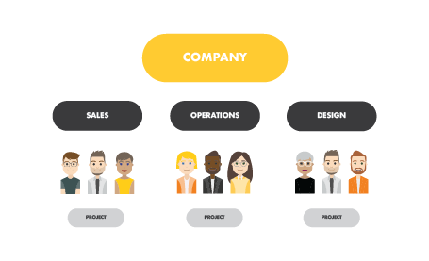
Forms and Functions
Functional Structures
  Organizing
  Leading
Divisional Structures
  Customer satisfaction
  Organizational revision
  Logistics
  Resources

Slide 6
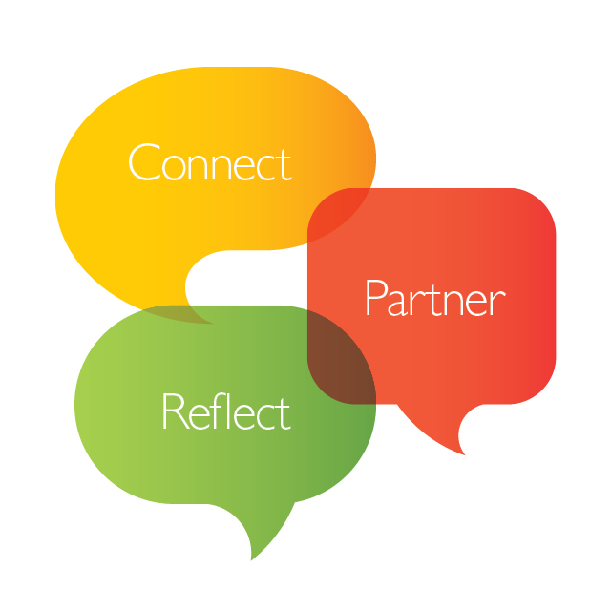
Communication Practices
Communication methods that are integrated in company-wide structuring
  Low to high communication of all teams and or division
  High communication with all regions/locations
  Phone calls; face-to-face conversations; conferences on a weekly biases
To have an effective communication. Especially, in all the companies' channels. Leveraging messages that are conveyed effectively to teams to achieve a common goal.

Slide 7
Organizational Mission, Vision and Goals
Mission Statement: The SNHU Pet Supply Company is staffed by a diverse group of more than 500 employees who love pets and appreciate the joy and friendship they bring to our homes and communities. We are a passionate, friendly group of people who strive to provide high-quality products and customer-first services across the nation to our customers and their pets.
Vision Statement: In short, a vision statement is a way for the company to position a company for the long-term establishment. It as well highlights the companies' outcomes that are vastly different than other companies.
Goals: The SNHU pet store aim is to make pet products accessible to pet parents that are pet friendly conscious. As well as increasing workplace satisfaction and delivering products that are of high quality.

